Slide 1

Brand360

Slide 2
Introduction
CCAvenue Brand 360° gives clear and comprehensive picture of the overall health of your online business as well as the visibility of your brand on leading Social Networks.
View feedbacks and engage with your fans on Social Media.
Monetize on your Brand presence and reputation to the fullest!

Slide 3
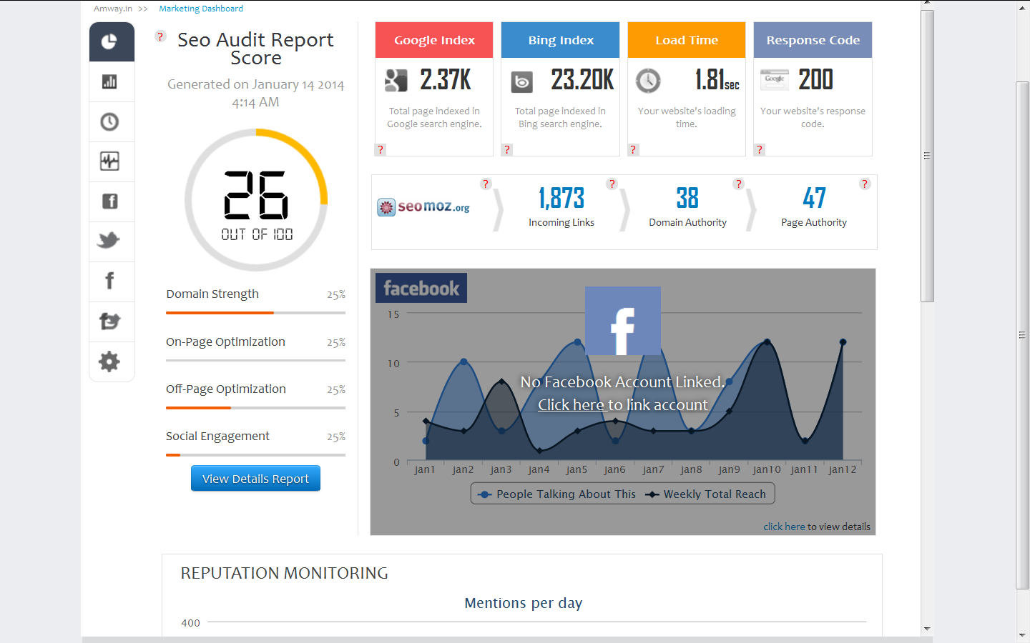

Slide 4
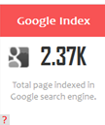
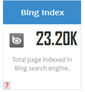
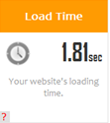
SEO
This number indicates the pages of your website present in Google's database. Ideally it is recommended to keep adding great content on the website to increase this number which in turn can bring in new search engine visitors.
This number indicates the pages of your website present in Bing's database. Again, it is recommended to keep adding great content on the website to increase this number.
This is the time in seconds taken to load the webpage. If it takes too long for a page to load, visitors would simply leave your site before it loads! Page load time is one of the ranking factors of search engine algorithms.

Slide 5
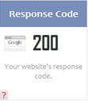


When your server receives a request for a page on your site, it returns a HTTP status code in response to the request. This status code gives information about your site and the requested page.
MOZ.com is one of the premium third party tools available which provides accurate data about your domain. We have setup APIs to fetch this data directly from the MOZ index and display it on the dashboard.
This is the number of backlinks pointing to your website according to the MOZ database.

Slide 6


Using over 150 ranking signals, Domain Authority is MOZ's calculated metric for how well a given domain is likely to rank in Google’s SERPs. Domain Authority is calculated on a 100-point, logarithmic scale.
Page Authority predicts the likelihood of a single page to rank well, regardless of its content. The higher the Page Authority, the greater the potential for that individual page to rank well in search results. Page Authority is calculated on a 100-point, logarithmic scale

Slide 7
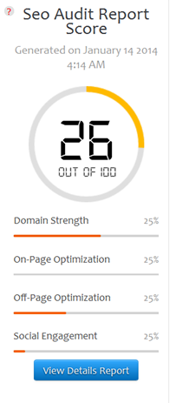
The SEO Audit Dashboard
The SEO Audit Report score is an indication of the strength and authority of the website which is based on many factors such as Domain Strength, On-Page Optimization, Off-Page Optimization and Social Engagement.
The higher the score the better.

Slide 8
The SEO Audit Dashboard
Domain Strength
This section checks the strength of your domain using metrics such as Domain Age & Expiry, number of pages indexed by Google and Bing.
On-Page Optimization
This section checks various factors like Meta Tags, Word count & density etc for your home page.
Off-Page Optimization
This section analyses backlinks to your website. We use backlink intelligence tools like SEOMoz to audit your website's Off Page Optimization.
Social Engagement
Social signals are becoming more important as part of search engine's ranking algorithm. This section checks Social bookmarking, Social Sharing and Social presence for your website.

Slide 9
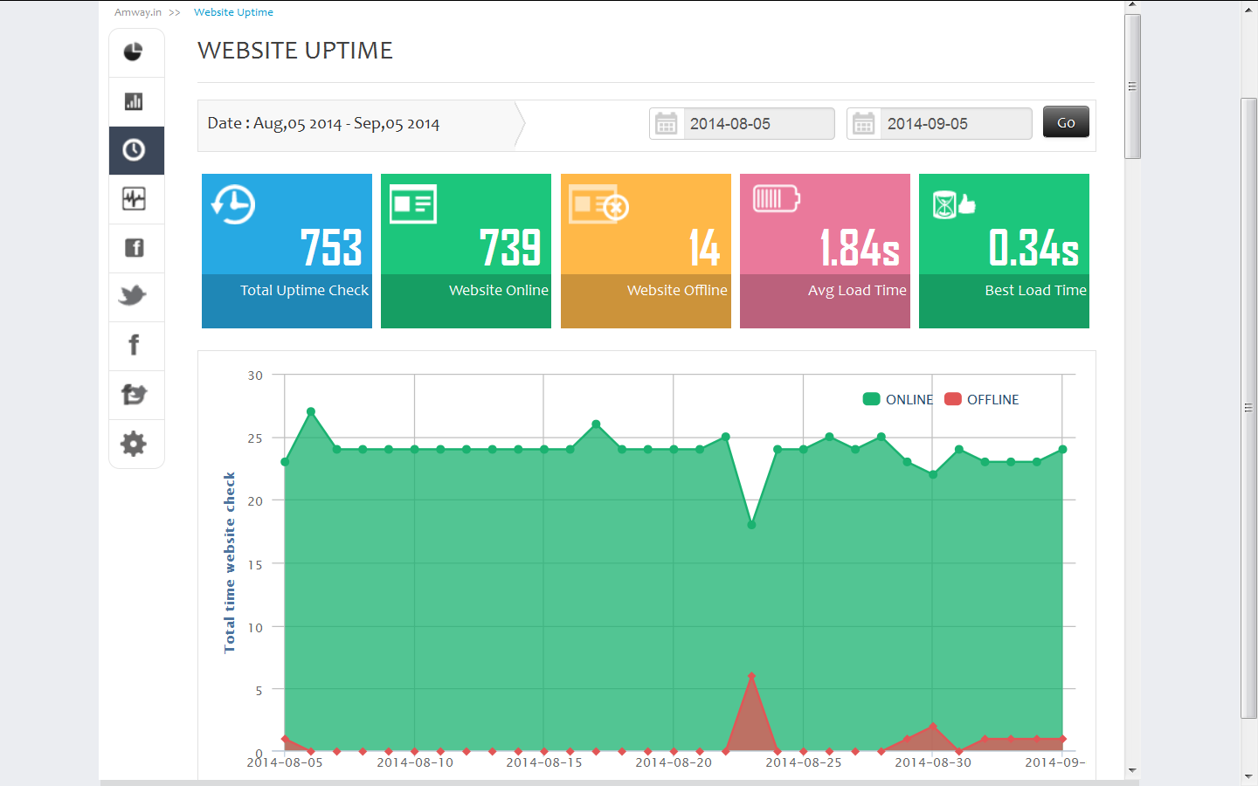
Website uptime

Slide 10
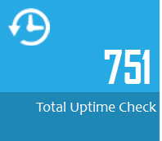
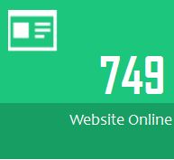
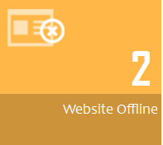
Website uptime
This number indicates the number of times your website was pinged.
This number indicates number of times the website was available
This number indicates number of times the website was unavailable

Slide 11
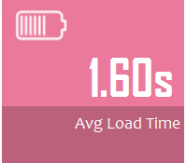
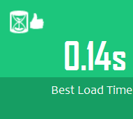
This time is the average time in seconds taken to load the webpage
The website loaded fastest at 0.14 secs

Slide 12
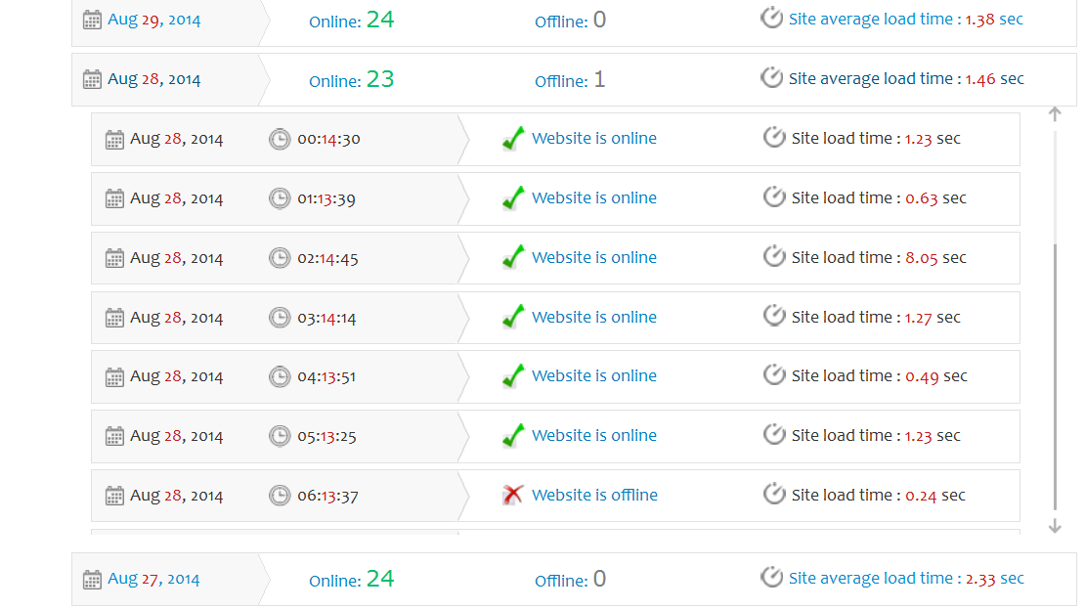
Break up of the website uptime
The break up of the no of times your website was pinged and when was it available &
unavailable are displayed here. Along with the load time.

Slide 13
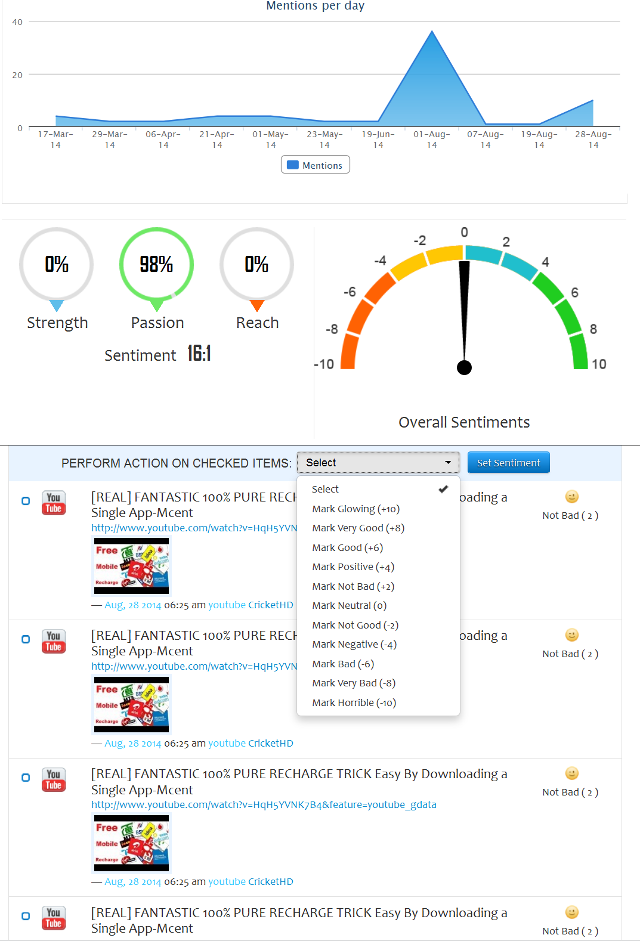
Reputation management

Slide 14
Reputation management
This section gives you an overview of:
No of mentions of your website
Top users on your portal
Top sources where you were mentioned
Listing of all the mentions
Facility to set the “Sentiments” for the postings for eg. Good, very good, neutral average etc.

Slide 15
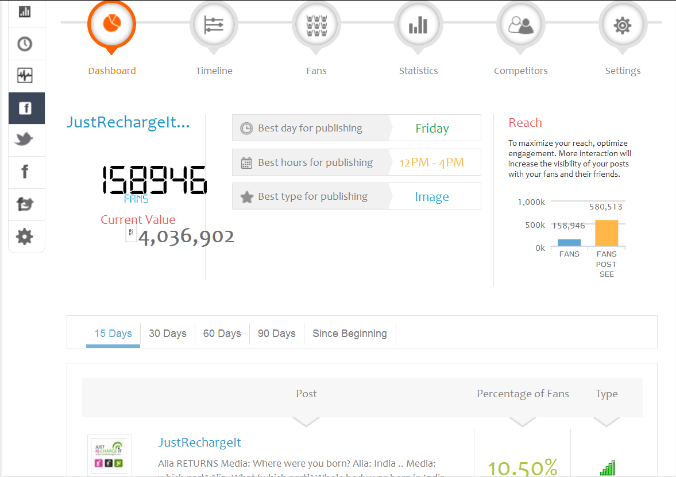
Facebook management

Slide 16
Facebook management
The Facebook Management Dashboard helps you analyze the following:
No. of Facebook fans.
Based of no of this , it give the best day to Publish
Best hours for publishing
Your reach , the reach can be maximized with more interactions.
It also pulls the posts and the relative information like % of Fan, their feedback.
Lists all your Fans.
Give statistics like:
  Fan Acquisition
  Reach
  Demographics
  Impressions by Location
You may add in names of your competitors to help you get counts how many
postings were made for them and how many feedback.
g) You may Determine the value of your page by setting value for various indicators.
All of the above can be done without having to log into your facebook account.

Slide 17
Thank
you

